Slide 1
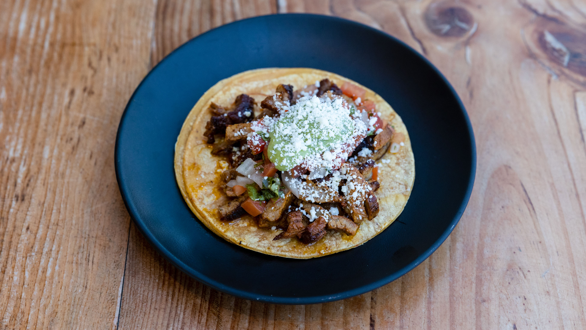
LAUNCH PLAN
Getting Linea on the road
Permits, equipment, and commissary, on a 2026 timeline | Daniel Rodriguez

Slide 2
01 TIMELINE
The road to opening
Q4 2025
Q1 2026
Q2 2026
Q4 2026
Save and research, lock the concept and menu
Cost the build, scout venues, draft the plan
Secure financing, reserve the commissary start
Buy and fit the van, pass inspections, open

Slide 3
02 EQUIPMENT
Build budget by category
Code required
• 3 compartment and hand sink
• Fresh and grey water tanks
• Fire suppression over the griddle
• Type 1 ventilation hood

Slide 4
03 COMMISSARY AND PERMITS
The legal base
• Lowcountry Shared Kitchen, 1956 Ashley River Road, West Ashley.
• Shared prep station, 20 hours a week, storage and water included.
• Membership $700 a month, $1,400 deposit, satisfies the city commissary rule.
• Mobile vendor license $250 a year, plus fire and health inspections.
• Status quote in hand, start reserved for the fourth quarter.
Monthly base cost
$700
Plus permits and fees of about $80 a month spread across the year. Thirty days notice to cancel after the first six months.

Slide 5
04 NEXT STEPS
Before the fourth quarter
• Confirm financing for the van and the code required safety build.
• Sign the commissary agreement and place the deposit to lock the start date.
• Submit the mobile vendor license with the menu and preparation methods.
• Reach out to the first three brewery and market venues for recurring slots.
• Finish the launch menu costing and order the wrap design.

